Slide 1
SDG 3 • GOOD HEALTH & WELL-BEING
GymTrack
Workout Coach
A simple chat-based workout tracker for gym beginners.
n8n + Telegram + ChatGPT
D. L. Dinh & Jou • Hackathon
GYMTRACK • SDG 3
1

Slide 2
THE PROBLEM
Beginners often lose track of their training
After one or two days, it is easy to forget exercises, weights, sets, cardio, or rest.
What can go wrong?
OUR FOCUS
People new to the gym who want an easy record of what they did.
Forgotten workouts
Users cannot clearly see their recent progress.
No simple reflection
It is harder to plan the next workout safely.
GymTrack turns a short chat message into a useful workout record and a supportive reply.
Less consistency
Progress can feel unclear or discouraging.
GYMTRACK • SDG 3
2

Slide 3
OUR SOLUTION
A simple workout log in chat
No complicated spreadsheet or fitness app is needed.
1
2
3
4
Log it
→
Process it
→
Reply
→
Save it
Send a message about weights, reps, cardio, steps, or rest.
n8n receives the message and checks recent workout history.
ChatGPT creates a short, supportive response and next goal.
The workout and feedback are stored for future reference.
Input → automation → feedback → stored history
GYMTRACK • SDG 3
3

Slide 4
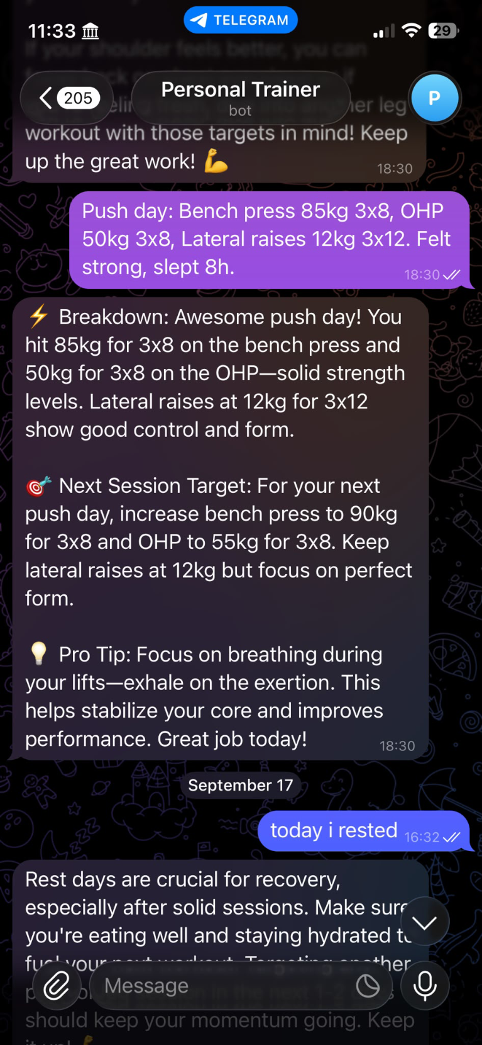
WORKING DEMO
Real Telegram response from GymTrack
This is proof of the full chat flow working from user input to automated feedback.
Example: push-day workout log
The user sends:
“Bench press 85kg 3×8, OHP 50kg 3×8, lateral raises 12kg 3×12. Slept 8h.”
Breakdown
The bot recognises the exercises, weights, and repetitions.
Next-session target
It provides a general target and reminder to focus on form.
Recovery response
When the user says they rested, it encourages recovery and hydration.
GYMTRACK • SDG 3
4

Slide 5
REQUIRED TOOL
How we used n8n
n8n connects the services and runs the workflow automatically.
1
Telegram Trigger
2
Google Sheets
Receives the user's workout chat message.
Reads past workouts and records the new entry.
3
ChatGPT
4
Telegram Reply
Writes concise encouragement and general feedback.
Sends the response to the same user chat.
GYMTRACK • SDG 3
5

Slide 6
USER VALUE
What GymTrack gives the user
The goal is simple: make workout reflection easier and more consistent.
✓
↗
★
Remember
Reflect
Stay encouraged
A record of exercises, sets, reps, weights, cardio, and rest.
A concise summary of what the user completed that day.
Positive messages help users continue their fitness habit.
GYMTRACK • SDG 3
6

Slide 7
RESPONSIBLE USE
Supportive feedback — not a personal trainer
Fitness guidance can cause harm if users treat it as professional or medical advice.
⚠ Risks
✓ Our response
Overtraining or injury
Clear limits
A user could lift too much or train while in pain.
General tracking and encouragement only; not medical advice.
Wrong level of trust
Safety reminders
Users may mistake automated feedback for qualified training advice.
Encourage rest, recovery, hydration, good form, and professional help where needed.
GYMTRACK • SDG 3
7

Slide 8
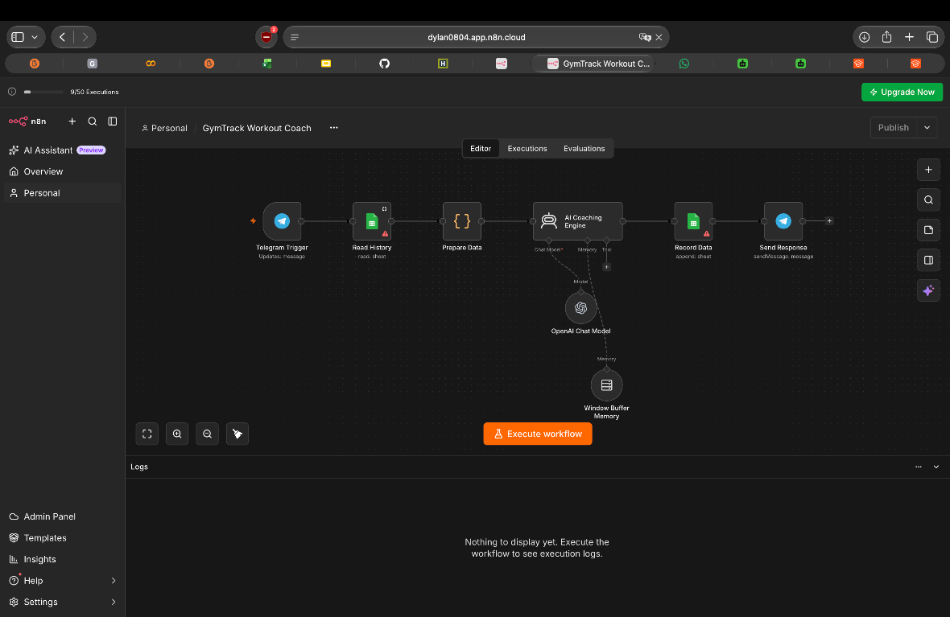
HOW THE WORKFLOW WORKS
n8n connects every step automatically
The workflow turns one Telegram workout message into stored history and a helpful reply.
FROM CHAT
TO COACHING
1
Telegram receives the workout log
2
Google Sheets reads recent history
3
ChatGPT creates feedback and a next goal
4
The new workout is saved
5
Telegram sends the reply back
GymTrack Workout Coach • n8n workflow proof

Slide 9
GYMTRACK WORKOUT COACH
Track. Reflect. Train responsibly.
A simple SDG 3 tool that helps beginner gym users remember and reflect on their workouts.
LIVE DEMO
1. Send a workout message in Telegram
2. Show the GymTrack reply
3. Point out the feedback and safety reminder
Thank you — questions?
GYMTRACK • SDG 3
8

